Slide 1
Cache Memory
By Muhammad Asim

Slide 2
Cache Memory
Cache is a small sized and fast memory
Which is placed in between CPU and Main Memory
Cache is a high speed volatile memory
Which contains most frequently accessed instructions and data
Located inside the CPU chip and motherboard

Slide 3
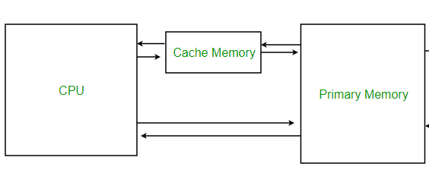
Cache Memory

Slide 4
Cache Memory
Whenever we need something we keep it with us.
The reason is whenever we want that thing we can access easily any time
The above example is fit to the cache memory
Whenever our cpu needs a data to access for process
The specific data required for processing is not found in cache memory. Then, the CPU sends a request to the main memory. Then, the main memory provides a copy of that data to the cache memory and the CPU.

Slide 5
Cache Memory(contd..)
Data transfers from main memory to cache memory in the form of blocks which means main memory provide
Data transfers in between cache memory and CPU is in form of words. The CPU accesses it in smaller units called words. The size of word typically a few bytes

Slide 6
Cache Hit and Cache Miss:
Cache Hit: If the required word is found in cache then it is called cache hit Hit Ratio = Hits / Hits + Miss h = no. of Hits / Total no. of CPU references
Cache Miss: If the required word is not found in cache then it is called cache miss Miss Ratio = Miss / Hits + Miss 1-h = no. of Miss/ Total no. of CPU references
Cache Access Time: It is time required to access the word from cache
Miss Penalty: The time required to fetch the required block from main memory
Average Access Time of CPU: Hit Ratio * Cache Access Time +(1-hit ratio)* miss penalty
=h * Tc +(1-h) *Tm

Slide 7
Numerical
Q: The access time of a cache memory is 100ns and that of main memory is 1000ns. It is estimated that 80% of the memory requests are for read & the remaining 20% for write. The hit ratio for read accesses only is 0.9. A write through is use.
What is the average access time of the system considering only memory read cycle.
What is the average access time of the system for both read & write cycles?
What is the hit ratio taking into considering the write cycles.
Sol:
Average access time of CPU = Hit Ratio * cache Access time+ (1-hit ratio) * miss penalty) or
= h * Tc + (1- h) * Tm
Notes:
1- hit ratio= miss ratio;
Miss penalty= cache memory + main memory access time.

Slide 8
Numerical(contd..)
Total read Access time = h * Tc + (1- h) * Tm = 0.9 * 100 + (1-0.9) * (100ns+1000ns) = 0.9 * 100 + (1-0.9) * 1100ns = 90 + 0.1 * 1100 =90 + 110ns =200ns Total write access time = 1 * max(100, 1000) = 1000ns
Average Access time for both read and write = 80% are read request + 20% are write request = 0.8 * 200 +0.2*1000 = 160 + 200 = 360ns
Hit ratio = 0.9/1 =0.9

Slide 9
Class Exercise
Q: The access time of a cache memory is 200ns and that of main memory is 1500ns. It is estimated that 60% of the memory requests are for read & the remaining 40% for write. The hit ratio for read accesses only is 0.7. A write through is use.
What is the average access time of the system considering only memory read cycle.
What is the average access time of the system for both read & write cycles?

